Slide 1
AUTUMN TERM 2022
ECA CLERKS BRIEFING
Tina Weavers. ECA Chair

Slide 3
My clerk makes the most boring meetings, where one person dominates the questioning [or where I have to lead governors’ questions] into a veritable disco and book club mix.
“A governor challenged …” “It was explained to Governors that … and as a result …”
She weaves Ofsted language into the minutes so it feels like I attended a cabinet session rather than my one hour monologue.

Slide 4
What Headteachers said would be ‘even better’
Better proof reading
Prompt response to emails
Acknowledging that there might be times when the clerk had misinterpreted a statement
Clerks make more time for Heads/Chairs/Office staff – be more part of The Team
Share their opinion of a Governing Body using their experience from others that they work with

Slide 5
AUTUMN TERM AGENDA: Focus for Governors/Trustees:
BUDGET!!!
Education Recovery Plan : spending funding in line with recovery priorities / educational outcomes
Supporting staff including CPD and wellbeing
Safeguarding: ensuring all policies, procedures and training are effective and comply with the latest changes in KCSiE
Teachers’ Pay: Recommendation –8.9% uplift to starting salaries and uplifts of between 5-8% along the rest of Main Pay Range – 5% for experienced teachers and those on Leadership Range

Slide 6
AUTUMN 2022
TERM
AGENDA

Slide 7
TIME TO BREAK OUT
If you were asked what advice you would give to someone thinking about becoming a governance professional, what would you say?

Slide 8
OFSTED
From 1 September 2022 – the following changes:
The names of inspections have been changed:
Section 5 inspections are now graded inspections
Section 8 inspections of good and outstanding schools are now ungraded inspections
Inspections with no formal designation and unannounced behaviour visits are now urgent inspections.

Slide 9
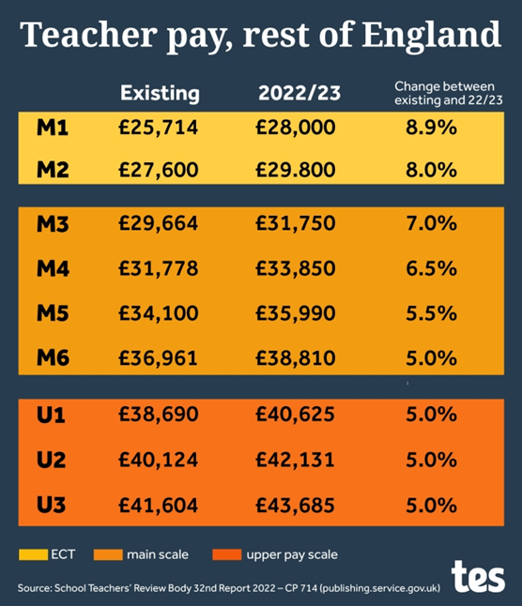
PAY COMMITTEES
Recommendations for salary increases for teachers 2022/23:8.9% for Main Pay Scale 1 [ECTs] – now starting at £28k
Rest of Main Pay Scale – between 5-8%
5% for the most experienced staff
5% for those with TLRs
5% for
those on Leadership Scale
Retention continues to be an issue – hence greater
increase at Main Scale
Consultation on draft 2022 School Teachers’ Pay and
Conditions Document to 23 September 2022 and will be
published on 14 October 2022

Slide 10
PAY COMMITTEES
Maintained schools: The board will normally delegate the day-to-day decision-making on pay to the headteacher but it retains ultimate responsibility for pay decisions
Academy Trusts: they can set their own procedures which is routinely that pay decisions are delegated to the LGBs [must be reflected in the SoD]. Some Trusts ask the LGBs to scrutinise the recommendations which are then approved by the Trust Pay Committee. Having a Pay Policy is recommended as best practice but is not statutory for academies.
DON’T FORGET: the DfE’s Implementing your school’s approach to pay

Slide 14
ACADEMY TRUSTS
Academy Trust Handbook[ finally!]
Planning Calendar
Academy Transfers
Next steps towards academisation
Due Diligence

Slide 15
INFORMATION UPDATE – all these documents are relevant to governing boards
DfE Careers Guidance
DfE Schools Causing Concern
DfE Searching, Screening & Confiscation
DfE Suspension & Permanent Exclusion guidance
Government guidance on Emergency Planning & Response
DfE What academies, free schools and colleges must or should publish online / DfE What maintained schools must publish online

Slide 16
INFORMATION UPDATE
NGA Guidance for Governors on School Food
NGA Guide for Governing Boards on Federations
Guidance on finding volunteers to become school governors and trustees
Guidance on getting school-to-school support to improve your school
Understanding your data: a guide for school governors and academy trustees

Slide 17
NEXT ECA BRIEFINGS
Tuesday, 10 January 2023 at 5pm
Tuesday, 18 April 2023 at 5pm [including ECA AGM]
NOTE FOR DIARY
NEXT ECA CONFERENCE
THURSDAY, 11 MAY 2023

