Slide 1
HEADTEACHER WELLBEING SURVEY
October/November
2021

Slide 2
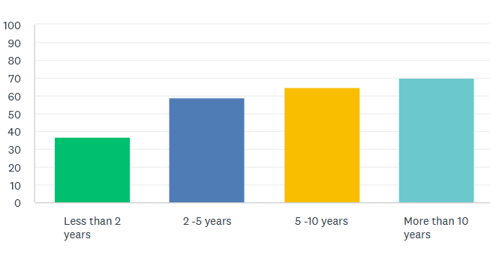
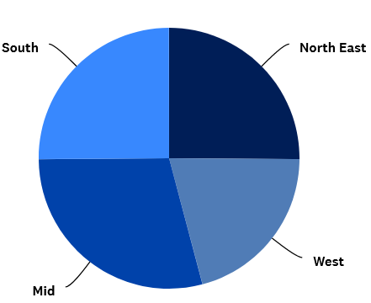
235 Essex primary-phase headteachers took part in the survey (over 50%)
Length of time as a headteacher
“Although I've been a HT for 12 years I've never felt so overwhelmed as I do at the moment.”
Essex quadrant
“As a new headteacher I find the job incredibly lonely. I work exceptionally long hours. I had always been a determined individual who wanted to become a headteacher, I am now regretting my decision.”

Slide 3
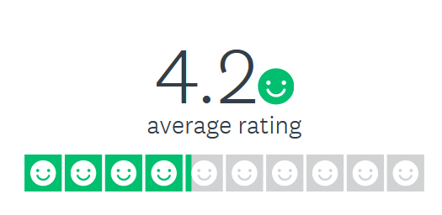
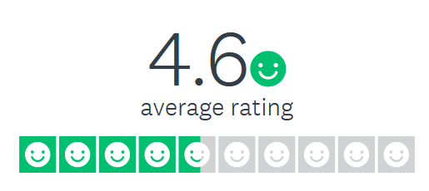
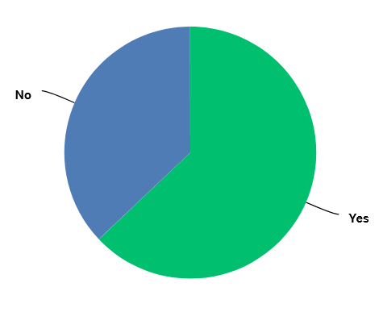
Work-life balance
“The management of Covid over the past 18 months has considerably affected workload for me as a Head, when I already have an extremely poor work life balance.”
How happy have you been in your professional role in the last 12 months?
If you had your time again, would you pursue your current headship?
“This has been the toughest time in my 15 years of headship. I am working in excess of 16 hours a day and most of the weekend just to stay on top of my workload.”

Slide 4
“Anecdotally, my son is 26. A few months ago, getting in from work I said 'I hate my job' and he said, 'In all my years, I have never, ever heard you say anything remotely like that about your work.”

Slide 5
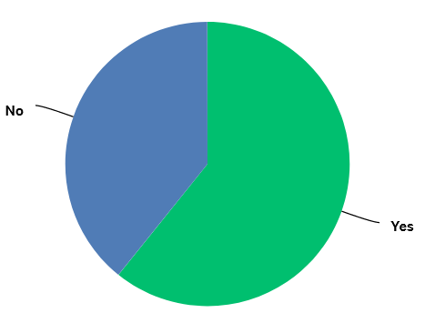
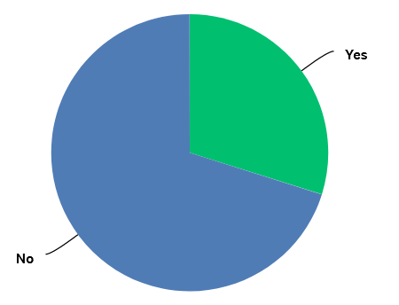
Have you considered resigning in the last 12 months?
“I absolutely love my job and feel very privileged to hold this position. However, the ridiculous pressure I feel from Ofsted following the stress of Covid, which is still with us, have made the job feel unmanageable. My stress levels are so high it makes me feel that I want to walk away from it all.”
Have you sought medical or clinical advice to help you cope with your role?
“I consider myself to be a very positive, resilient person and I despair of people who like to dwell on the negatives of the job, however, it is extremely difficult to maintain this positivity and not get drawn into poor wellbeing. Only yesterday, I thought 'what else is there?' and if I wasn't the main earner at home, would change careers. I don't have that as a realistic option.”

Slide 6
“The approach taken appears a binary one. Move into lockdown and all priorities are altered and the expectation that Heads are considered and supported, for their own wellbeing, is raised. Exit lockdown and there is a climate of normality in the expectations that Heads can deliver, be held to public scrutiny, and provide recovery, at a time when we have more Covid cases than ever before, more staff absence than ever before, a greater workload than ever before, and are still very much dealing with the reality of the day to day impact in the school.
I am concerned for my team, and every day have to accept my own vulnerability, and put it to one side. The old adage states that you have to look after yourself first, take dedicated time, make space ... but under such challenging circumstances this is exceptionally difficult, and my presence needed more than ever to be the glue that holds the organisation together.
Exhaustion levels are significant, and I think the gap between what is expected of me, and what we are able to deliver, is widening and adds to the stress. I know I will not be alone, or that this is a nationwide issue.
Now is the toughest it has been.”

Slide 7
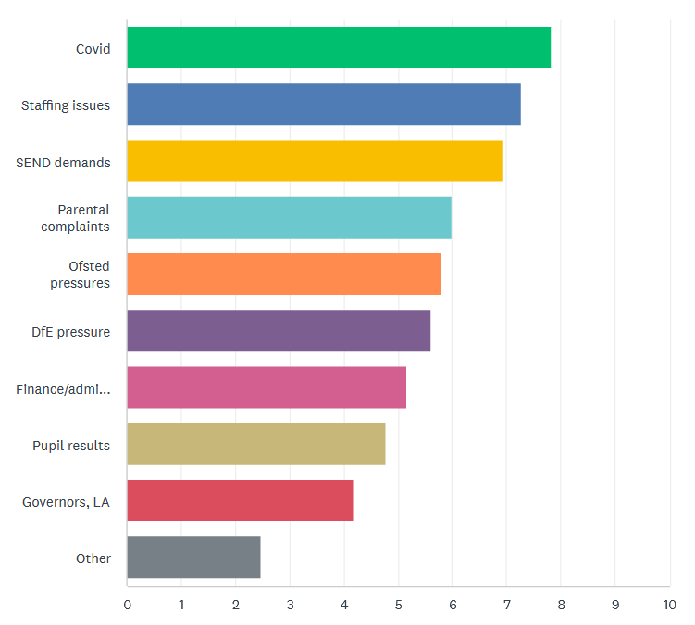
What factors have caused you the most stress/anxiety at work in the last 12 months?

Slide 8
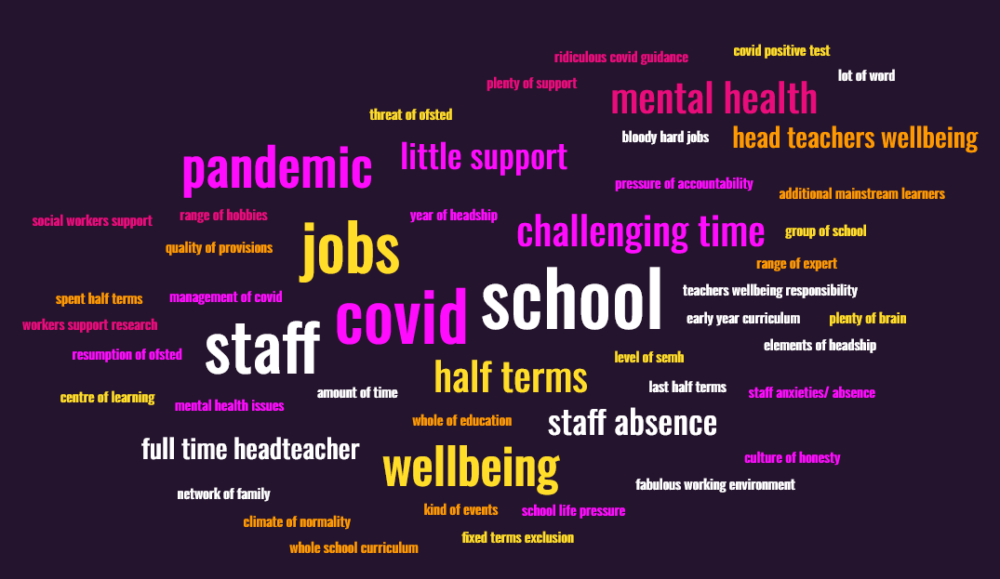

Slide 9
“It was incredibly hard to rank the stressors as it depends on the day, if I am being honest. I have never known a term as difficult as the first half of this term. It is the first time I have ever considered resigning from education completely.”
“I think the job is now so work heavy that it is impossible to do a good job without working 18 hours a day. No amount of coaching etc would change that unfortunately. I am a fairly positive individual who accesses and maintains my own mental health well but you cannot change the continuous pressures of Ofsted, changes, parents and paperwork; the pressures of managing Covid has also completely changed the job for me. It is like Ofsted and the LA have completely forgotten the pandemic has taken place and it is business as usual, except anyone actually working in school knows that this is not true with staff absence/wellbeing at its highest and being one person trying to manage this is unachievable.”

Slide 10
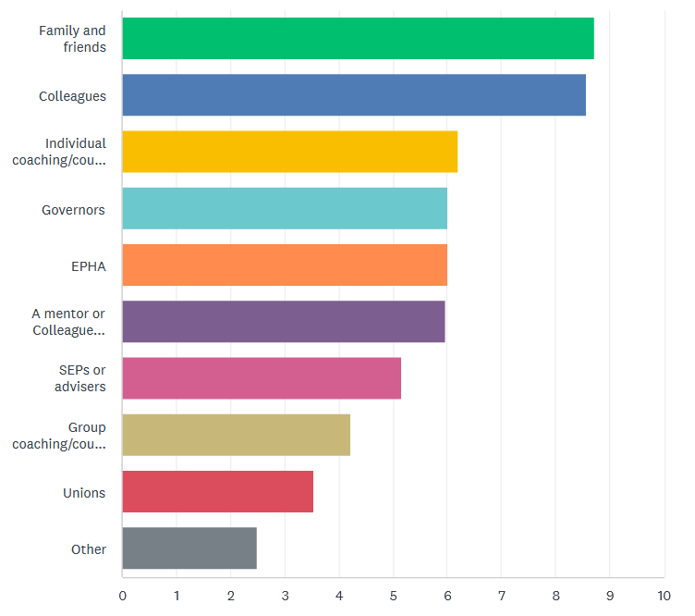
What support helps?

Slide 11
What support could EPHA offer?
We plan to facilitate a range of support in addition to the current EPHA offer, which will include signposting or brokering practical help for heads in crisis, such as:
Coaching or counselling – individually or in a group
Colleague Support for any headteacher in need (not just new heads)
Capacity help in a school – headteachers or deputies seconded to help add leadership capacity for a limited time
Governance advice and support, including recommending clerks who can manage “statutory” meetings
Legal support for complaints
Bespoke training, including joint training on complaints for headteachers and governors
We will also continue to work and lobby on behalf of all Essex Primary-phase headteachers, including sharing the results of this survey at a local and national level.

Slide 12
Discussion
What needs to change?
What additional support would help you?

